Slide 2
Executive Summary (Mark – 5 min)
Overview, Business Case, Goals
The Approach
Exploratory Data (Dan – 5 min)
Modelling (Sean – 5 min)
Conclusions (see Final Report)
Key Insights (Dan, except for Zero Boat. 5 min. Joe – Zero Boat 2 min)
Recommendations:
Data Governance/Management Recommendations (Joe – 5 min)
Operational (Dan – 5 min)
Dashboard/Mobile App Demo (Dylon – 5 min)

Slide 3
Regression
Sean

Slide 4
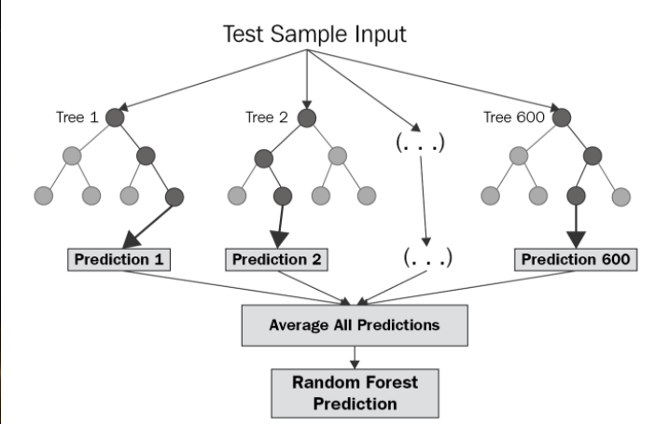
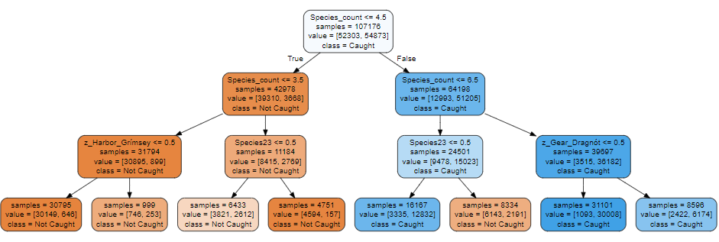
Overview of Tree Modeling
Three types of tree modeling techniques:
Decision trees
Simple but less accurate
Random forests
More accurate but more complex
Utilize an ensemble of decision trees
Gradient boosting
One of the most common machine learning algorithms
Used for their speed and accuracy, even in the presence of large datasets
Random Forest Technique
Decision Tree for Predicting Whether Gullkarfi Was Caught

Slide 5
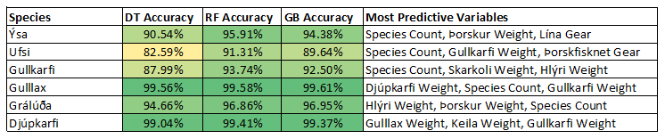
Applying Tree Modeling to the Icelandic Fishing Industry
Predicting species count
Variables predictive of species count were recognized after the trip had already occurred
Identifying commonalities among inspected trips
Lack of inspection data did not result in worthwhile results
Determining whether a species was caught on a given trip
Demonstrated accuracy in its predictions and highlighted different predictive variables for each species
Summary Table for Predicting Whether a Species is Caught on a Given Trip

Slide 6
Pricing Dataset
Clear non-linearities within the dataset, lack computing power to fully explore
No correlation with lagging price avg. with the same day price
Contracts versus market
Notes:
PCA, low variation explained
32GB of ram

Slide 7
Zero Boat Construction: Sampling
Inspected trips create observations where no discard occurs
To implement the zero boat mechanism, inspection selection must be random
Stratified random inspections
95% Confidence Level is recommended
Trade-off between resource constraints and acceptable margin of error
Would change inspections from an enforcement mechanism to a sampling mechanism
Sampling inspections would allow the development of models that determine which trips deviate from the norm
Notes:
Can create a sample of trips that are representative of the population of trips
Subject to resource constraints, two inspection programs can be run: sampling inspections and enforcement inspections

Slide 8
Recommendations: Data Governance and Management
Include LandingsID in pricing data
Develop export SOPs for external researchers
tsv (tab separated values) or | for delimited exports
Schema/data dictionaries
Feature engineering that captures knowledge
Example: identifying Pelagic and Groundfish within the datasets
Notes:
LandingsID is a key field that allows for the joining of data from multiple sources such as landings data and pricing data.
Queries, delimited files, schema/data dictionaries can help ensure the new researchers are on the same page and reduce the learning curve.

